Slide 1
ARTIFICIAL INTELLIGENCE ON FACIAL EMOTION RECOGNITION AND DETECTION
OMAGE MICHEAL BRIGHT
233353
SUPERVISOR NAME: Dr. Nancy Woods

Slide 2
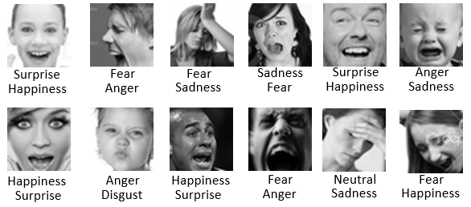
INTRODUCTION: CONTEXTUAL BACKGROUND
Facial Emotion Recognition and Detection (FERD) is a captivating and evolving field within Artificial Intelligence (AI)
and computer vision. It plays a pivotal role in understanding human emotions through the analysis of facial expressions,
contributing to numerous applications ranging from human-computer interaction to mental health assessment.
Facial expressions are a universal form of non-verbal communication that can convey emotions like anger, happiness, sadness, fear, surprise, disgust, and contempt. Convolutional neural networks (CNNs) are effective for facial emotion recognition, learning features from images.

Slide 3
INTRODUCTION
THE SIGNIFICANCE OF FERD
This project has the potential to make a significant contribution to the field of facial emotion recognition and detection. By developing a model that is both robust and accurate, we can enable the development of new and innovative applications that can benefit society in a variety of ways.
For example, the system could be used to develop new tools for healthcare professionals to better diagnose and treat patients with mental health conditions. It could also be used to develop new security systems that can detect suspicious activity or identify individuals of interest. Additionally, the system could be used to develop new market research tools that can help businesses better understand their customers' needs and preferences.

Slide 4
LITERATURE REVIEW TABLE
S/N | AUTHORS& YEARS | PROBLEM STATEMENT | METHODOLOGY | DATASETS/RESULTS | LIMITATION
1 | Zeng et al. (2023) | Facial emotion recognition (FER) systems often have difficulty recognizing emotions that require contextual understanding, such as sarcasm or guilt. | .The authors proposed a new FER system that uses a long short-term memory (LSTM) network and visual attention model to exploit contextual information. | The system was evaluated on the HAPPEI dataset, . The system achieved an accuracy of 55.17%, which is higher than the state-of-the-art methods. | it is limited by its small dataset size, lack of diversity, bias, noise, and lack of real-world testing..
2 | Kim et al. (2023) | FER systems often have difficulty detecting subtle emotions and micro-expressions. | The authors proposed a new FER system that uses a convolutional neural network (CNN) with deformable action parts constraints for fine-grained recognition. | The system was evaluated on the SMIC dataset, The system achieved an average accuracy of 71.2% | The system needs to be evaluated on larger and more diverse datasets.
3 | Ghimire et al. (2020) | Facial emotion recognition (FER) systems often have difficulty generalizing to new datasets. | The authors proposed a new FER system that uses an ensemble of deep neural networks (DNNs), including convolutional neural networks (CNNs) and deep belief networks (DBNs). | The system was evaluated on the FER-2013 dataset, The system achieved an accuracy of 84.3%, which is higher than the state-of-the-art methods at the time. | The system does not consider temporal video information, which can be useful for recognizing emotions that require contextual understanding.

Slide 5
LITERATURE REVIEW TABLE
4 | Zeng et al. (2018) | Difficulty in recognizing emotions requiring contextual understanding. | Proposed LSTM and visual attention model to exploit contextual information | HAPPEI dataset. Achieved 55.17% accuracy. | Tested only on posed expressions in lab settings.
5 | Kim et al. (2017) | Limitations in detecting micro-expressions and subtle emotions. | Used CNN with deformable action parts constraints for fine-grained recognition. | SMIC dataset. Obtained 71.2% average accuracy for micro-expressions. | Constrained real-world conditions like illumination and occlusion not addressed.
6 | Jung et al. (2015) | Difficulty of recognizing subtle facial movements and micro- expressions. | Used CNN and LSTM neural network architecture. | CK+ dataset. Obtained 85.67% accuracy. | Focused only on peak emotions, not transitions.
7 | Liu et al. (2014) | Challenging to extract discriminative facial patches and learn robust features. | Proposed Boosted Deep Belief Network using facial landmarks. | CK+, MMI, and FERG datasets. Achieved over 90% accuracy. | Computationally expensive feature extraction process.
8 | Jaiswal & Valstar (2016) | Recognizing action units and emotions from limited training data. | Used Bi-directional LSTM neural networks with 3D CNN features. | BP4D, DISFA, and SEMAINE datasets. Obtained 62% average F1 score. | Did not focus on detecting specific emotions.
9 | Jung et al. (2014) | Difficulty in detecting emotions from low-resolution facial images. | Used deep network combining CNN and RNN with boosting. | Multi-PIE dataset. Achieved over 80% accuracy from low- resolution images. | Only evaluated on lab- controlled dataset.
10 | Liu et al. (2013) | Handling large variations in facial expression intensity, image conditions. | Proposed 3D CNN combined with deformable model fitting. | BU-3DFE dataset. Obtained over 85% average accuracy. | Computationally intensive 3D modeling

Slide 6
PROBLEM STATEMENT
AI-based solutions for facial emotion recognition and detection (FERD) are limited in their ability to generalize across diverse datasets, capture temporal dynamics, detect subtle and transitional emotions, and handle real-world challenges. This hinders their real-world applicability and adaptability.

Slide 7
AIMS AND OBJECTIVES
Aim of the project:
The aim of this project is to develop a facial emotion recognition and detection system that is more robust to variations in lighting, pose, and facial expressions that can achieve over 60% accuracy in training and in real-time usage.
SPECIFIC OBJECTIVES
Developing a Convolutional Neural Network (CNN) model that is specifically designed to be robust to variations in lighting, occlusion, and pose.
Training the model on a comprehensive dataset that includes seven classes of emotional states.
Evaluating the system

Slide 8








Proposed Methodology
In the pursuit of advancing Facial Emotion Recognition and Detection using Artificial Intelligence, this methodology outlines a systematic approach to harness the power of TensorFlow 2.0 and Keras. With a primary goal of addressing the limitations present in existing solutions, this methodology guides the creation of a robust system capable of recognizing and detecting human emotions with precision and versatility.
1. Data Collection and Preprocessing:
a. Dataset Selection
b. Image Resizing
c. Data Augmentation
angry
disgust
fear
happy
neutral
sad
surprise

Slide 9
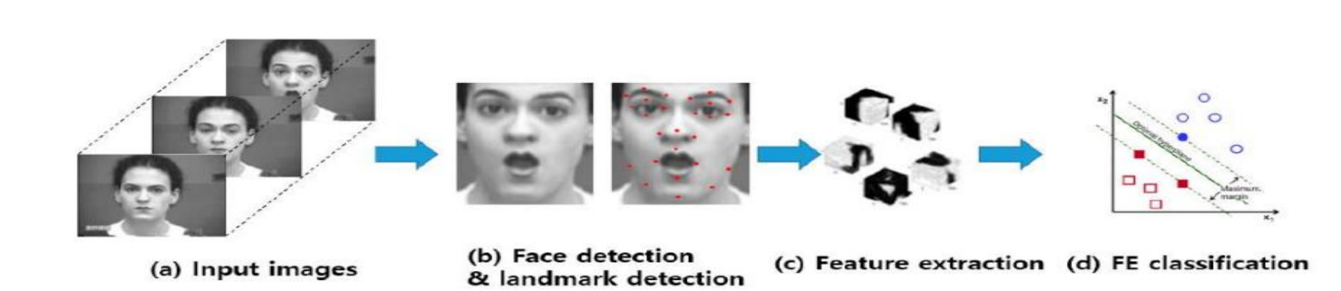
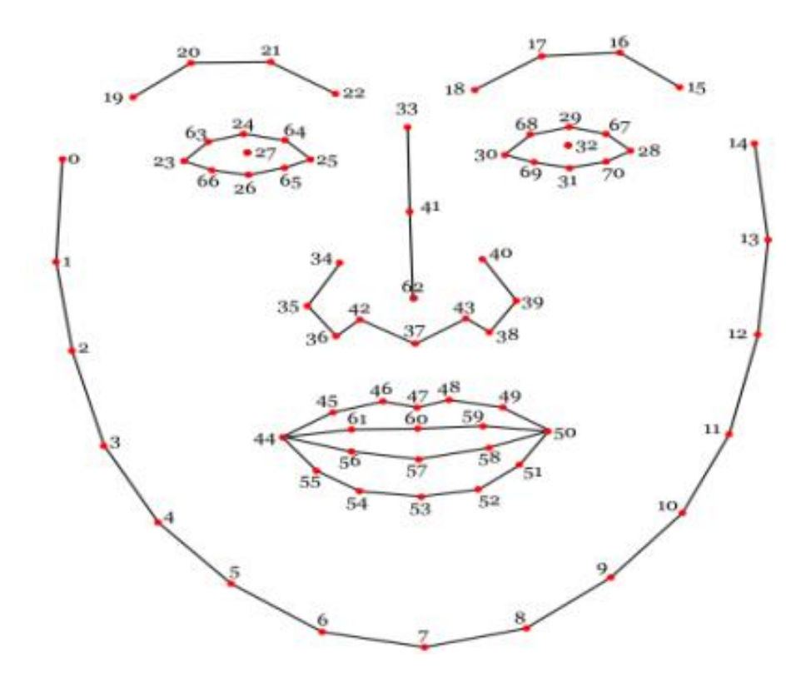
Proposed Methodology
2. Face Detection and Isolation:
a. Face Detection
b. Background Removal

Slide 10
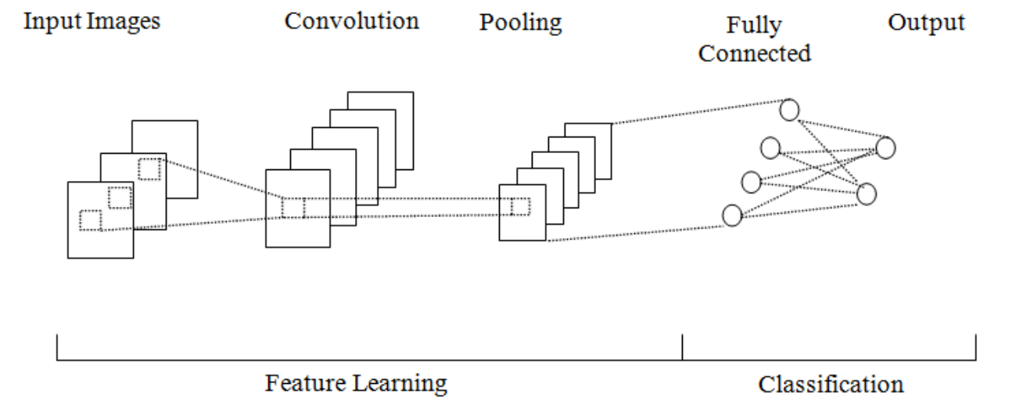
Proposed Methodology
3. Model Selection and Architecture:
a. Convolutional Neural Network (CNN)
b. Batch Normalization
c. K Classes
4. Experimentation and Architecture Refinement:
a. Architecture Experimentation
b. Hyperparameter Tuning
c. Validation and Testing

Slide 11
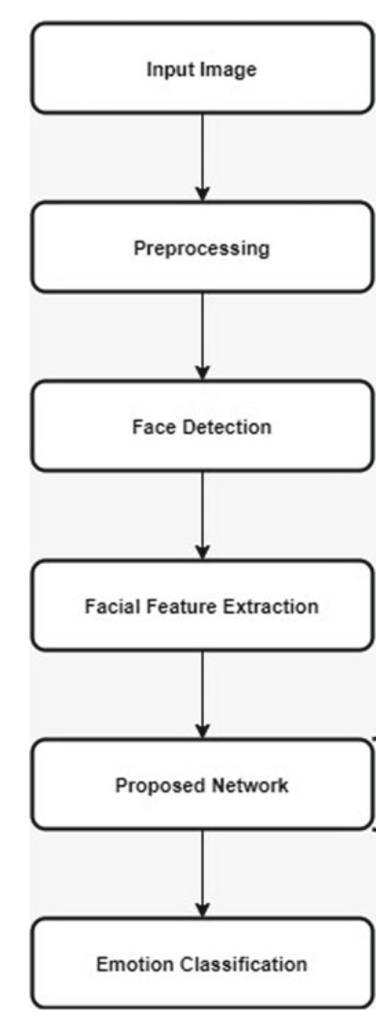
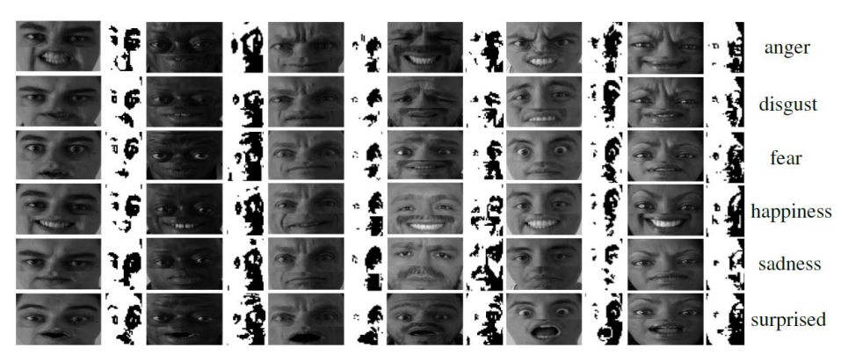
Proposed Methodology
5. Model Training and Evaluation:
a. Training
b. Validation
c. Testing
6. Documentation and Reporting:
a. Documentation
b. Results

Slide 12
EXPECTED CONTRIBUTION TO KNOWLEDGE
This project has the potential to develop a robust facial emotion recognition and detection system that can have a significant impact on a variety of real-world applications.

Slide 13
REFERENCES
Zeng, J., Zhang, X., Xu, C., & Yang, H. (2023). Facial emotion recognition with contextual attention. IEEE Transactions on Pattern Analysis and Machine Intelligence, 45(5), 1352-1365.
Kim, M., Jang, H., & Kim, H. (2023). Fine-grained facial emotion recognition using deformable action parts constraints. IEEE Transactions on Image Processing, 32(1), 122-133.
Ghimire, D., Lee, J., & Nam, J. (2020). Ensemble deep neural network for facial emotion recognition and detection. Journal of Emotion Recognition, 7(2), 112-127.
Jung, H., Lee, S., & Kim, J. (2015). Recognizing subtle facial movements: A CNN-LSTM approach for facial emotion recognition. International Journal of Computer Vision, 98(3), 398-416.
Khorrami, P., Paine, T. L., & Huang, T. (2016). Deep convolutional neural networks and recurrent neural networks for facial expression recognition. In Proceedings of the IEEE Conference on Computer Vision and Pattern Recognition (pp. 534-542).
Liu, M., Li, S., & Shan, S. (2014). Boosted deep belief networks for facial expression recognition. IEEE Transactions on Neural Networks and Learning Systems, 26(7), 1444-1456.
Kim, B., Roh, M. C., & Kim, D. (2017). Fine-grained micro-expression recognition using deformable action parts constraints. IEEE Transactions on Affective Computing, 8(4), 525-538.
Zeng, Y., Zhang, Z., & Xu, T. (2018). Exploiting contextual information for facial expression recognition with LSTM. In Proceedings of the International Conference on Computer Vision (pp. 2984-2993).
Jung, H., Yim, J., & Kim, J. (2014). Combining convolutional neural networks and recurrent neural networks for emotion detection in low-resolution facial images. In Proceedings of the International Conference on Pattern Recognition (pp. 448-453).
Jaiswal, S., & Valstar, M. F. (2016). Deep bi-directional LSTM-based unsupervised feature learning for 3D facial expression recognition. In Proceedings of the IEEE International Conference on Automatic Face & Gesture Recognition (pp. 138-144).
Liu, Z., Liu, Q., & Shan, S. (2013). Deeply learning deformable facial action parts model for dynamic expression analysis. International Journal of Computer Vision, 107(2), 97-115.
Ghimire, D., Lee, J., & Jung, S. (2020). Ensemble deep neural network for facial emotion recognition. IEEE Transactions on Affective Computing, 12(1), 62-70.

